Slide 1



Trending Song Analysis
YouTube

Slide 2


Dataset Details:
Video_id: Unique identifier for each YouTube video.
ChannelTitle: Title of the YouTube channel publishing the song.
Title: Title of the YouTube song video.
description: Description provided for the YouTube song video.
tags: Tags associated with the YouTube song video.
PublishedAt: Date and time when the YouTube song video was published.
ViewCount: Number of views received by the YouTube song video.
LikeCount: Number of likes received by the YouTube song video.
FavoriteCount: Number of times the YouTube song video has been marked as a favourite.
CommentCount: Number of comments posted on the YouTube song video.
Duration: Duration of the YouTube song video.
definition: Video definition or quality (e.g., HD, SD).
caption: Availability of captions for the YouTube song video

Slide 3
Objective
Data Cleaning and Preparation:
Clean and preprocess the dataset, addressing missing values or outliers.
Convert relevant columns to appropriate data types.
Exploratory Data Analysis (EDA):
Explore patterns and distributions in view counts, like counts, and comments.
Identify trends in the popularity and engagement of YouTube song videos.
Content and Channel Analysis:
Analyze the distribution of videos across different channels.
Identify popular tags and their correlation with view counts.
Temporal Trends:
Explore how YouTube song video metrics vary over time.
Identify peak publishing times and their impact on engagement.
User Engagement Insights:
Investigate relationships between likes, comments, and views.
Identify factors influencing user engagement with YouTube song videos.

Slide 4
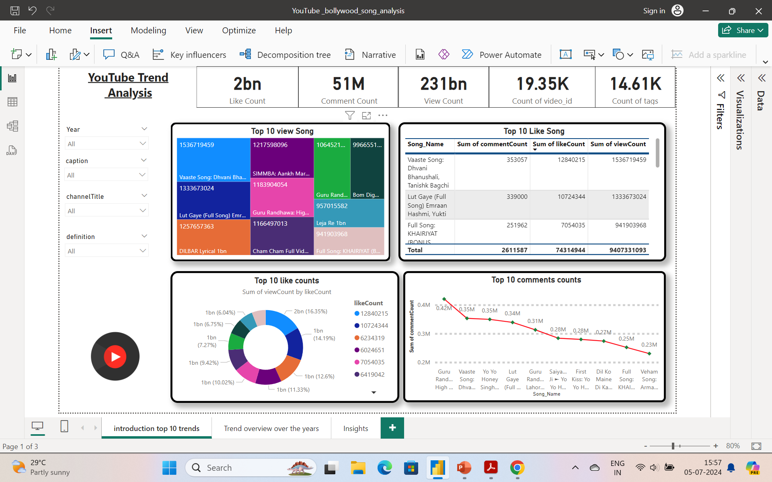



:
Introduction
Top 10
Playlist
Like
Comment

Slide 5
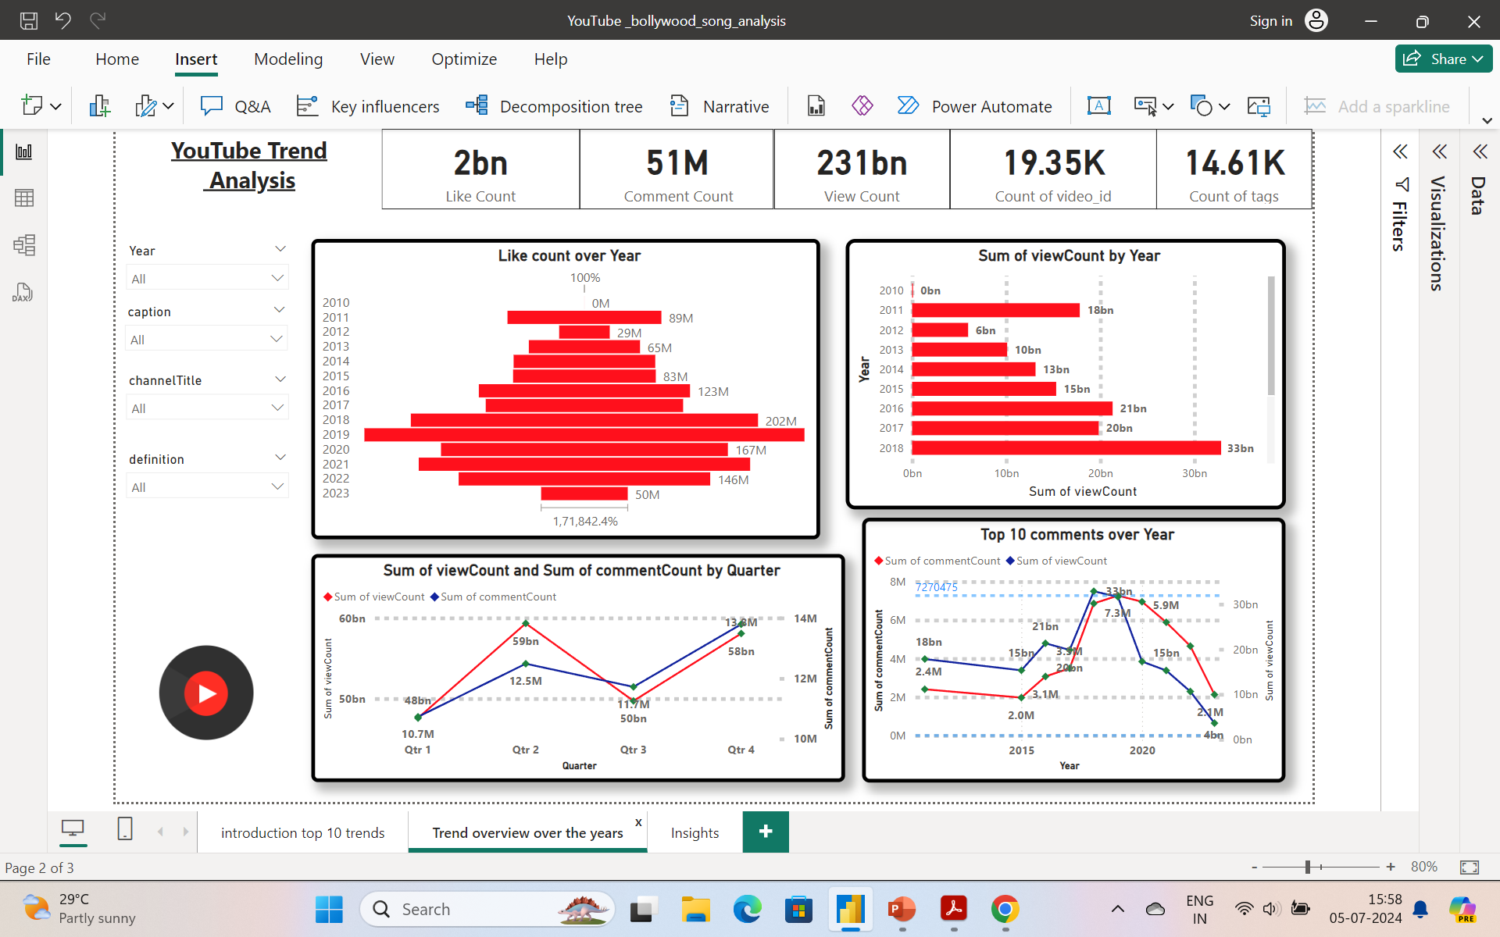

Temporal Trend

Slide 6

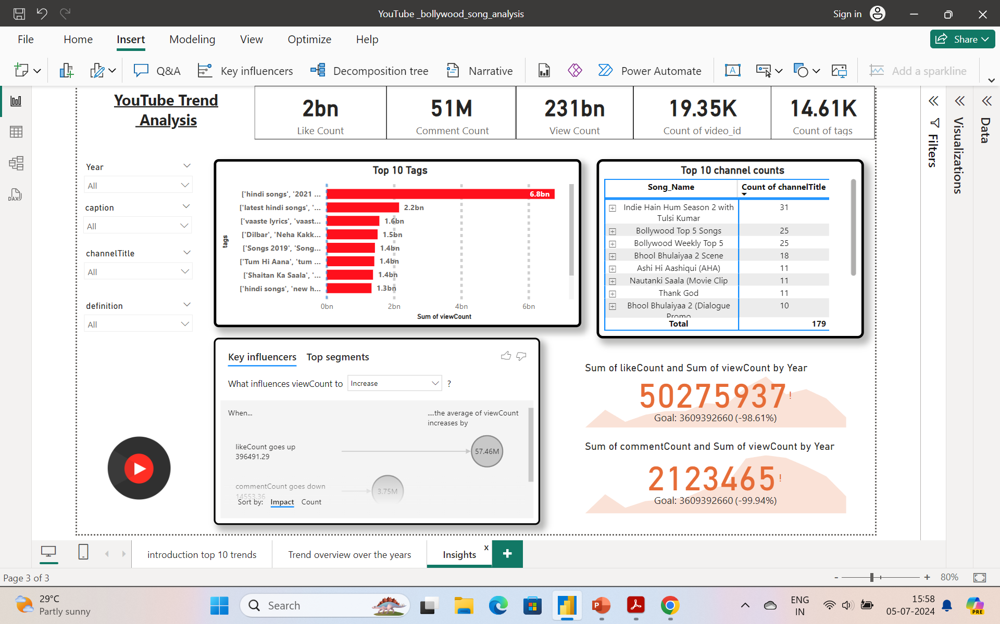
Content and Channel Analysis

Slide 7
Summary
Overall Engagement:
Total like count: 2 billion
Sum of comment count: 51 million
Total view count: 231 billion
Total number of videos: 19.35K
Total count of tags: 14.61K
View-Engagement Insights:
Top Most Viewed Song: "Vaste" by Dhvani Bhanushali with 1,536,719,459 views, the highest like count of 12,840,215, but a relatively low comment count of 353,057.
Top Most Commented Song:** "High Rated Gabru" by Guru Randhawa with 420,000 comments, the 5th most viewed song with 1,183,904,052 views.
Temporal Trends:
2018: Significant growth in engagement, becoming the highest view year with 33 billion views.
2019: Highest like count year with 254 million likes, followed by fluctuations in engagement levels.
Active Quarters: Q2 and Q4 are the most active for viewer engagement.
2019: Highest comment rate year with 7,270,475 comments, followed by a decline.

Slide 8


Thank you

